Slide 1
Readmission Prediction of Diabetic Patients
Tejasvi Sharma

Slide 2
PROBLEM DEFINITION AND MOTIVATION
Diabetes is a chronic condition affecting people of all ages and is prevalent in around 23.2 million people in the U.S. The objective of this project is to predict the probability of a diabetic patient being readmitted. The results from this research will help hospitals design a follow-up protocol to ensure that patients having a higher readmission probability are doing well to promote a healthy doctor-patient.
Hospital readmissions for Diabetes patients are very expensive since hospitals face severe penalties if the readmission rate is higher than expected. Therefore, in order to ensure better value, more satisfied patients and reduced readmission rates an attempt has been made by me to identify the key factors that influence readmission of diabetes patients and predict the probability of diabetic patients’ readmission.
Data Source -https://archive.ics.uci.edu/ml/datasets/diabetes+130-us+hospitals+for+years+1999-2008
Notes:
23.2 million people in the U.S have diabetes which is roughly 7.2 percent of the US population.

Slide 3
About the Data
The dataset under consideration represents 10 years of clinical care and includes over 50 features representing patient and hospital outcomes.This problem falls under the category of Classification problem and suitable Classification Algorithms like Random Forest, Decision Trees, Logistic Regression are expected to help identify if a patient needs to readmitted or not.
It contains clinical records from over 100,000 individual encounter corresponding to over 60,000 distinct patients. The data was collected from over 74 million encounters related to 17 million patients.

Slide 4
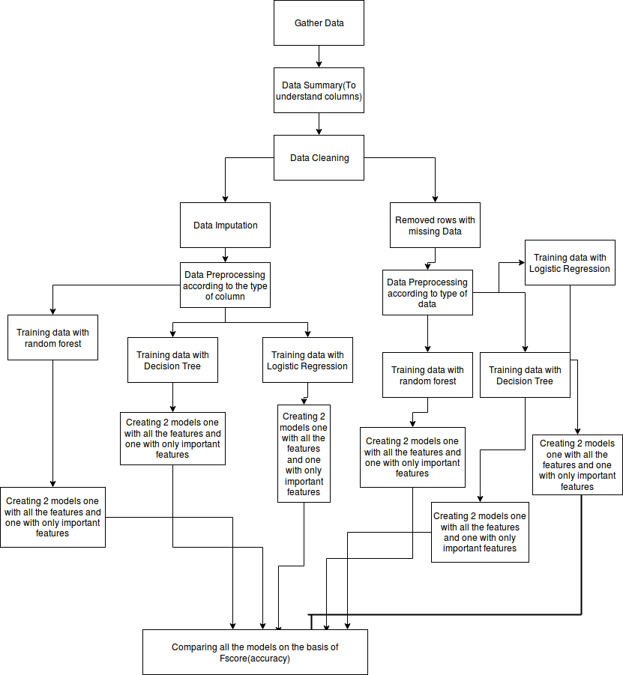
Method

Slide 5
Target Column and Use cases
Target column in the data set is readmission , which is a categorical column and has three values >30, <30, NO.
NO means no readmission. >30 means readmission after 30 days of discharge. <30 means readmission before 30 days of discharge.
Use Case 1: Converted >30 and <30 to Yes and converted the column to a binary column and used machine learning algorithms predict yes or no for readmission and find columns affecting the readmission
Use Case 2: Used only >30 and <30 . Tried to find if readmission is True then whether that will be within a month or after a mont h and the factors affecting it.

Slide 6
Exploratory Data Analysis
In the exploratory Data Analysis, I analysed some columns which I thought could play an important role in my Analysis.
Results are in github for both usecase1 and usecase2.
Link Use _Case 1: https://github.com/tsharmagw/PracticeProject/blob/master/GW_data_hack/Gwu_Data_Hack_use_case1.ipynb
Link Use_Case 2: https://github.com/tsharmagw/PracticeProject/blob/master/GW_data_hack/Gwu_Data_Hack_use_case2.ipynb

Slide 7
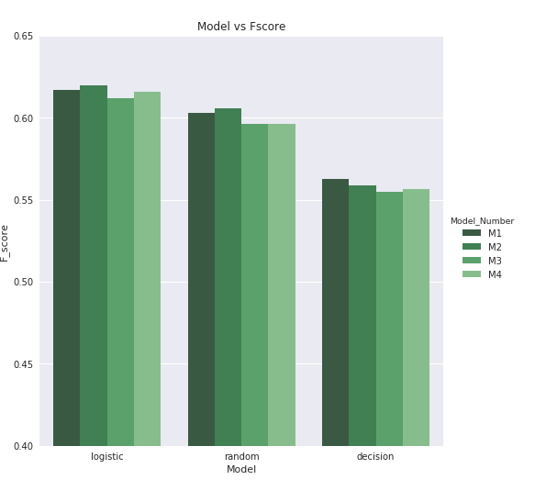
Results
Use Case 1: This gave an accuracy of around 62 percent using Logistic regression.
M1- Model with imputed Data.
M2- Model with rows having missing data removed.
M3- Model with imputed Data but only with best features.
M4- Model with rows having missing data removed but with only best features

Slide 8
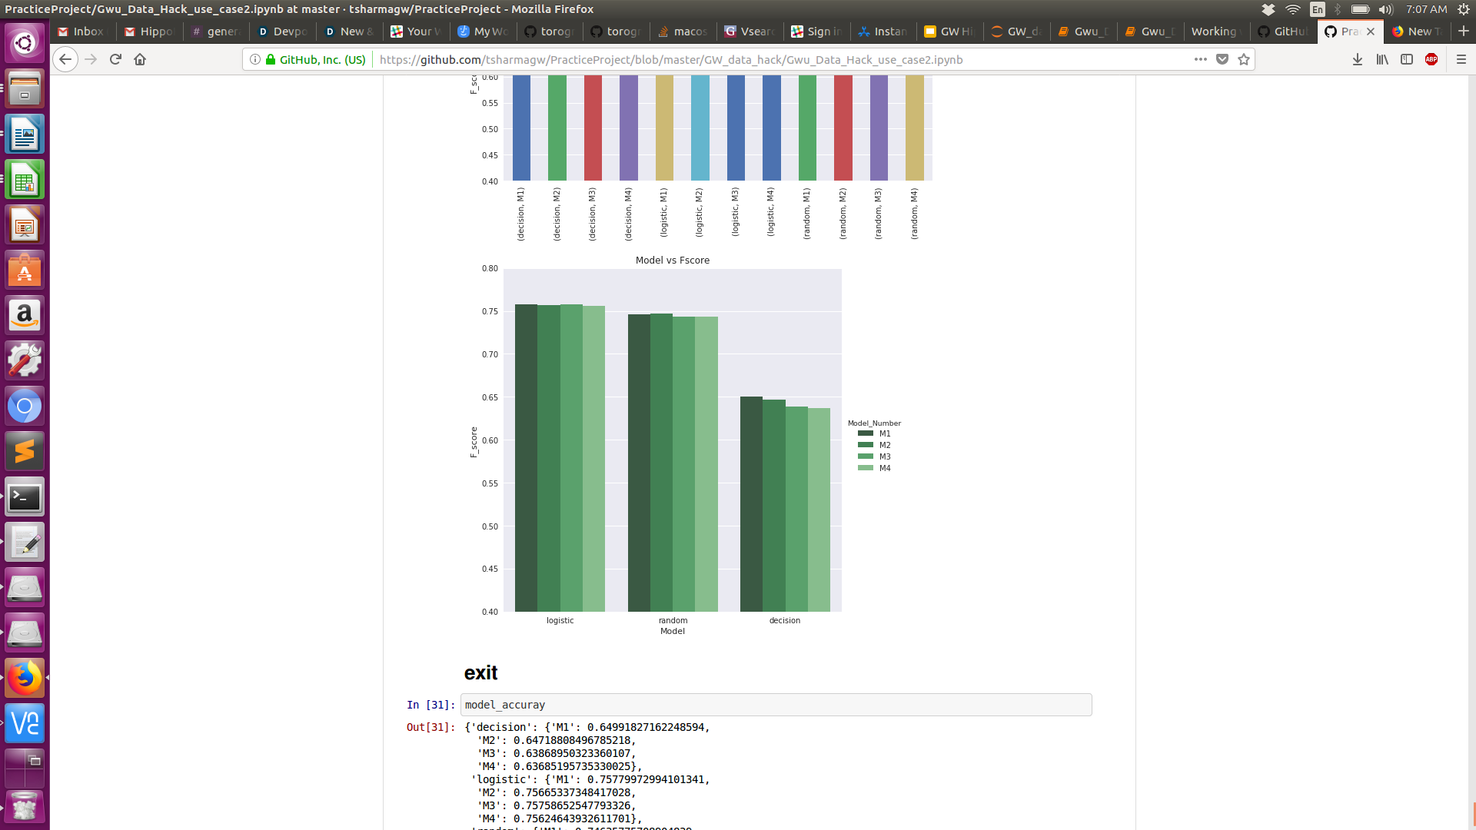
Results Continued
Use Case 2: This gave an accuracy of around 75.77 percent using Logistic regression.
M1- Model with imputed Data.
M2- Model with rows having missing data removed.
M3- Model with imputed Data but only with best features.
M4- Model with rows having missing data removed but with only best features

Slide 9
Conclusion
This can be used to predict readmission for person diagnosed with diabetes and help them get proper care. In future, an app can be made with the trained model in the backend. Data regarding the patient can be filled in the UI by the doctor itself, then the data goes through the machine learning pipeline, to clean and preprocess it and then give a result for readmission.
If the result it true, it can further classify whether the readmission will be within 30 days or after 30 days. These results can help a doctor and patient.

